Slide 1


Air Traveling Safety Data
Southwest Airlines

Slide 2
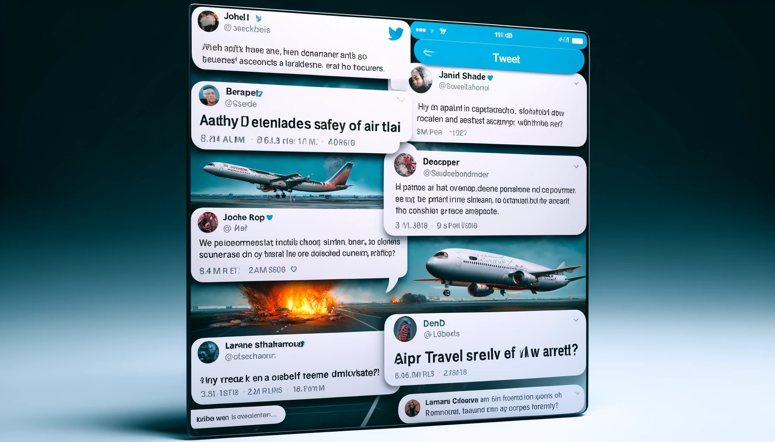
Problem statement
In the light of recent airplane accidents, there has been a surge in media coverage, inundating the public with messages that portray air travel as increasingly unsafe.
This heightened perception of risk poses a significant challenge for airlines including Southwest airlines, as it is undermining public trust in air travel.
Southwest airlines is addressing this issue seriously and provides data-driven reassurance that air traveling is still the safest way of traveling.

Slide 3
Executive summary
Internal Data Science team conducted research regarding the air traveling with data-driven conclusion.
Air traveling remains the safest way of traveling with 38,038,658 departures and only total 555 reported accidents in 2020.
Risks of jet fatalities are close to 0
Southwest airlines maintains the high standards for its safety with 0 fatal accidents since 1985 comparing to 159 total fatal accidents (9404 fatalities) globally.

Slide 4
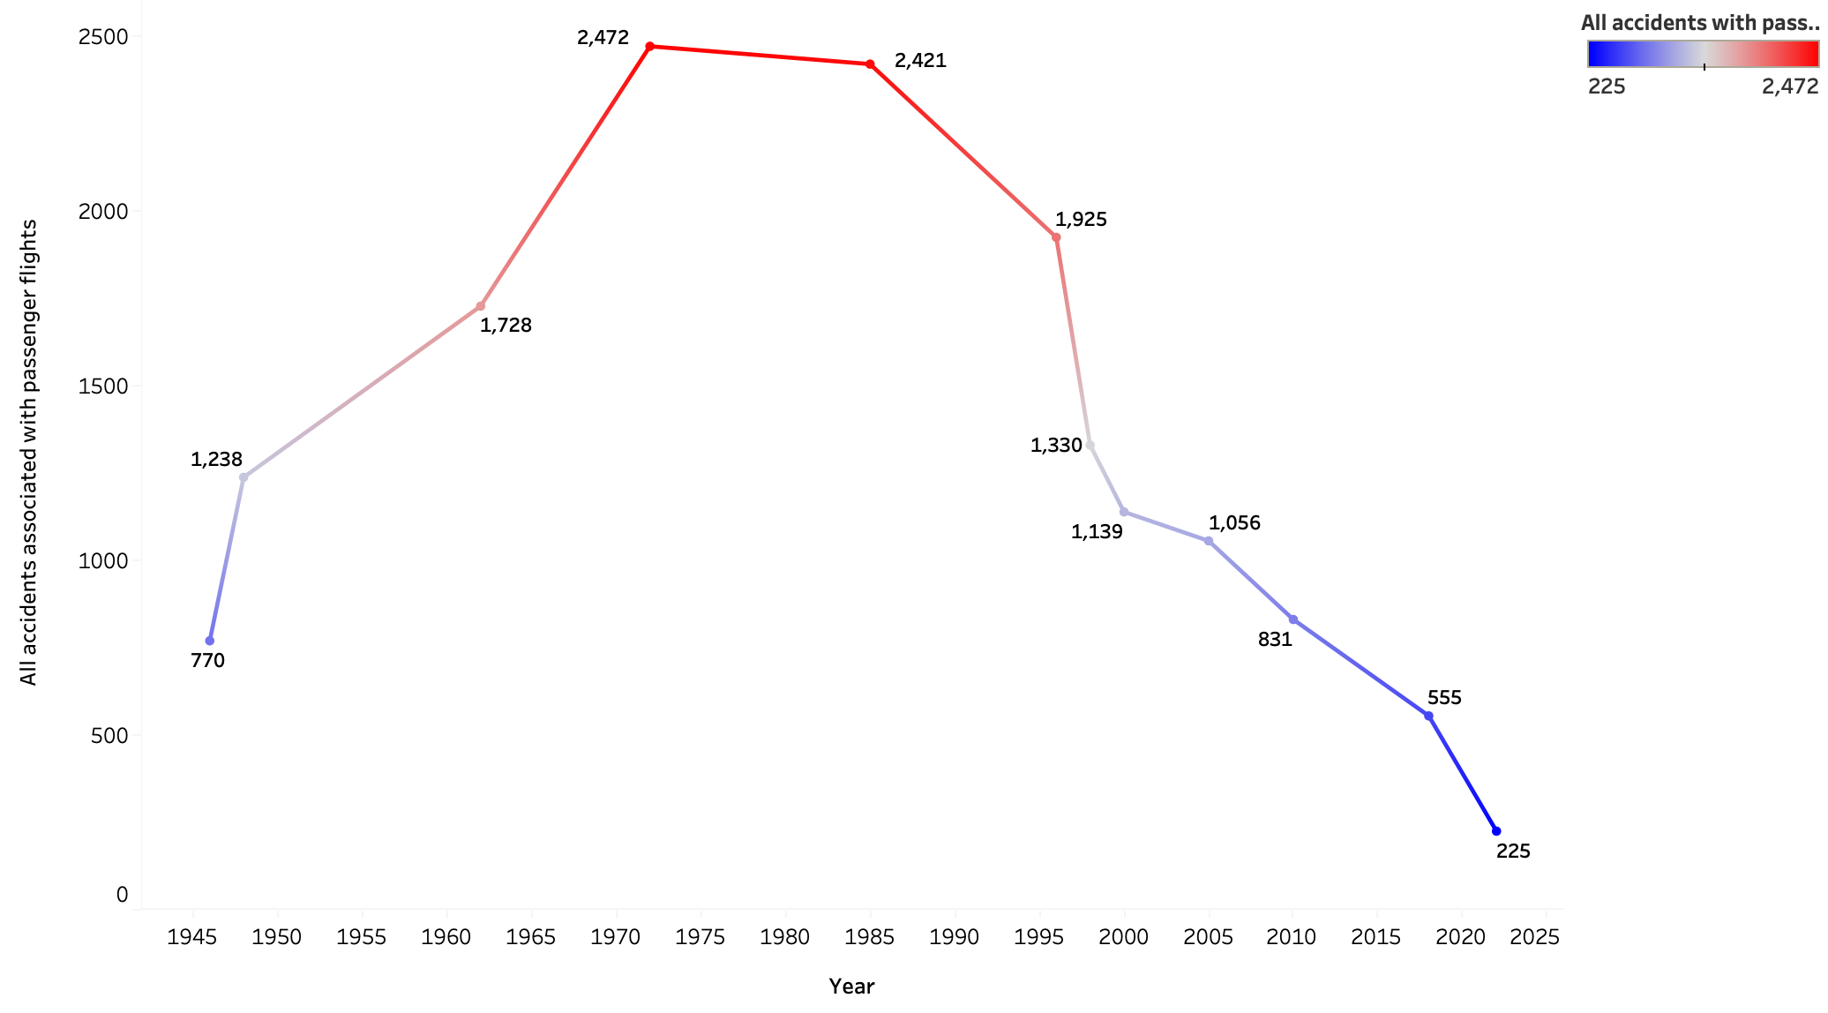
Air traveling is still the safest way of traveling with number of departures increasing and number of accidents decreasing yearly
Departures
Accidents

Slide 5
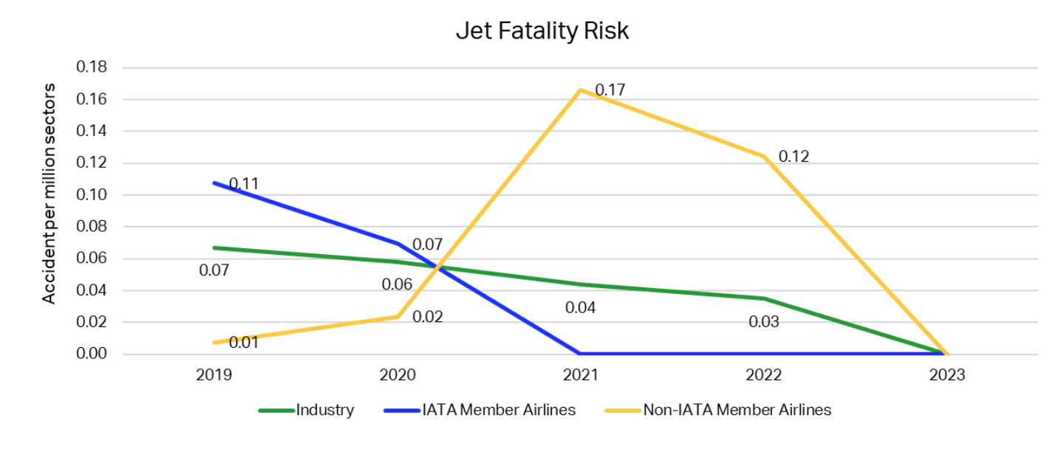
IATA (International Transportation Association) recent reports demonstrates the risk of jet fatality in 2023 is close to 0.

Slide 6
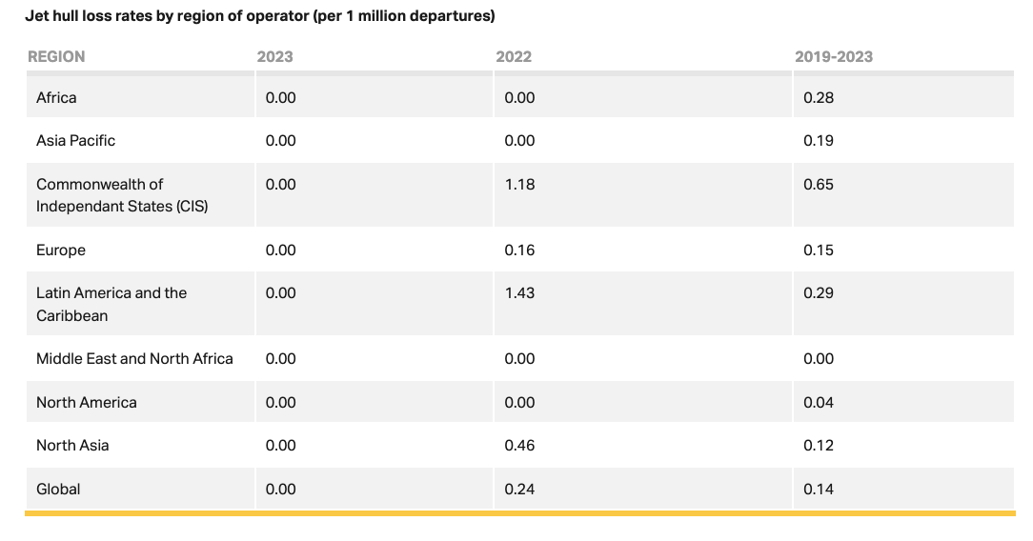
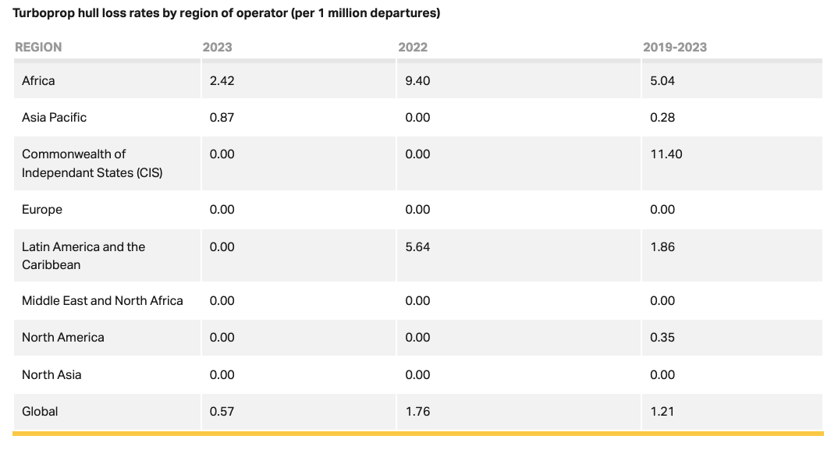
According to IATA the number of major accidents related to jet hull loss and turboprop hull loss is extremely low in North America.
This ensures the high quality of airplane maintenance and strict safety protocols

Slide 7
Southwest Airlines keeps its high safety standards maintaining 0 fatal accidents and 0 fatalities since 1985
The average number of accidents across major airlines

Slide 8
Conclusion
Passenger Increase: 2023 saw a record 8.7 billion passengers, indicating strong growth and trust in air travel.
Safety Record: Major airplane failures have decreased to a record low, significantly reducing accident risks.
Continuous Safety Investment: Ongoing investment in safety technology and training is crucial to maintaining low risk levels.
Southwest's Excellence: Southwest Airlines maintains an outstanding safety record, continuing to meet high safety standards.
Market Positioning: Leveraging our safety record can attract safety-conscious travelers, increasing market share and brand loyalty.

